Slide 1
Fandango Movie Rating Discrepancy Analysis
CAPSTONE PROJECT
Presented By:
1.SIVASANGARI.S
Lord Jegannath College of Engineering and Technology
B.E Robotics and Automation - 3rd year

Slide 2
OUTLINE
Problem Statement
Proposed System/Solution
System Development Approach
Algorithm & Deployment
Result
Conclusion
Future Scope
References

Slide 3
Problem Statement
Movie dataset for binary sentiment classification containing substantially more data than previous benchmark datasets. We provide a set of 25,000 highly polar movie reviews for training and 25,000 for testing. So, predict the number of positive and negative reviews using either classification or deep learning algorithms.

Slide 4
Proposed Solution
Data Preparation:
Text Preprocessing
Feature Extraction
Model Training
Model Evaluation

Slide 5
System Approach
Traditional Machine Learning Approach
Deep Learning Approach

Slide 6
Algorithm & Deployment
import numpy as np
import pandas as pd
import matplotlib.pyplot as plt
import seaborn as sns
from sklearn.feature_extraction.text import CountVectorizer
from sklearn.linear_model import LogisticRegression
from sklearn.ensemble import RandomForestClassifier
from sklearn.tree import DecisionTreeClassifier
from sklearn.metrics import roc_auc_score, f1_score, accuracy_score
from bs4 import BeautifulSoup
import re
import nltk
from sklearn.model_selection import train_test_split
from sklearn.utils import shuffle
from nltk.corpus import stopwords
import warnings
warnings.filterwarnings("ignore")

Slide 7
df_ = pd.read_csv('IMDB Dataset.csv')
df = df_.copy()
def missing_values_analysis(df):
na_columns_ = [col for col in df.columns if df[col].isnull().sum() > 0]
n_miss = df[na_columns_].isnull().sum().sort_values(ascending=True)
ratio_ = (df[na_columns_].isnull().sum() / df.shape[0] * 100).sort_values(ascending=True)
missing_df = pd.concat([n_miss, np.round(ratio_, 2)], axis=1, keys=['Total Missing Values', 'Ratio'])
missing_df = pd.DataFrame(missing_df)
return missing_df
def check_df(df, head=5):
print("--------------------- Shape --------------------")
print(df.shape)
print("-------------------- Types ---------------------")
print(df.dtypes)
print("----------------- NaN Analysis -----------------")
print(missing_values_analysis(df))
print("--------------------- Head ---------------------")
print(df.head())
check_df(df)

Slide 8
a , ax = plt.subplots(1,2,figsize=(22,9))
df['sentiment'].value_counts().plot.pie(explode=[0,0.1], autopct='%1.2f%%',ax=ax[0],shadow=True, startangle=300, colors = ["#bcbddc", "#efedf5"])
ax[0].set_title('Distribution of Positive / Negative Emotions')
ax[0].set_ylabel('')
sns.countplot('sentiment', data = df ,ax=ax[1], palette=["#bcbddc", "#efedf5"])
ax[1].set_title('Distribution of Positive / Negative Emotions')
plt.show()
plt.show()
df.groupby(['sentiment'])[['sentiment']].count()

Slide 9
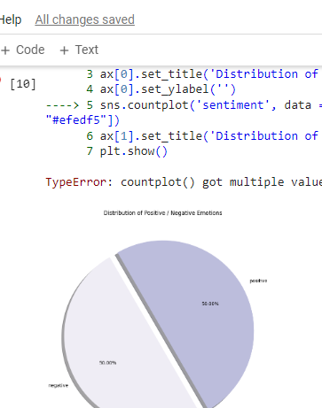
Result
Sentiment
Negative 25000
Positive 25000

Slide 10
Conclusion
50 % negative and 50 % positive

Slide 11
Future scope
Handling Imbalanced Data
Model Improvement and Tuning
Transfer Learning and Pre-trained Models
Multi-Modal Analysis

Slide 12
References
Barnes, “Disney Selling Film Tickets on Facebook, 2010.
Orwall, “Theatres Plan Web Venture, 2000. Bond. “Fandango. Movie Tickets, 2010. https://www.multichannel.com/news/comcast-considers-internet-video-push-332553 Edgerton, Gary. “The Multiplex: The Modern American Motion Picture Theater as Message.” Journal of Popular Film and Television. Bond, Paul. 2013. “CinemaCon: Fandango Adds 500 Screens. Hollywood Reporter. April 16. https://www.hollywoodreporter.com/news/cinemacon-fandango-adds-500- screens.

Slide 13
THANK YOU

